Slide 1
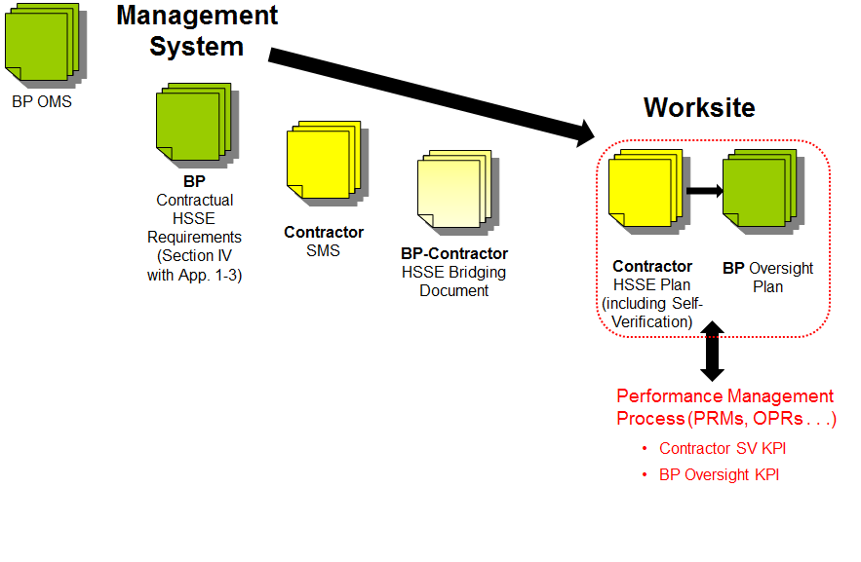
HSSE Bridging Overview

Slide 2
HSSE Bridging Overview
What it does:
Compares Key Requirements with Contractor Procedures
Identifies gaps & variances, agrees action to close gaps
Specifies whether BP or Contractor procedures have primacy
Defines interfaces where both BP and Contractor procedures will be followed
Highlights key elements for the HSSE and SV Plans
What it doesn’t do:
Detailed bridging of Scope of Work technical practices (that aren’t HSSE related)
Document general policies and organization information (e.g. signed HSSE Organizational Policy Statement)
Detailed interface diagrams for general operations
Amend the Contract

Slide 3
HSSE Bridging

Slide 4
HSSE Plan
The purposes of the HSSE Plan are to record and communicate to PERSONNEL how the HSSE Requirements referenced in Clause 3.0 below shall apply to WORK. The HSSE Plan may include reference to ‘work packs’ or other standard WORK-related documentation.

Slide 5
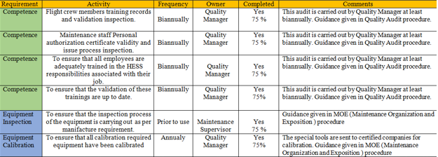
SV Plan
The Contractor SV Plan is the mechanism by which the Contractor demonstrates they are performing the necessary checks to verify their conformance to applicable requirements. The SV activities identified are connected to the following three topics, at a minimum
competence
equipment and/or inspection
procedures

Slide 6
Document link
http://nasupplierhsse.bpglobal.com/gom/gom.aspx
Copy and paste link into browser
Under communications tab you will see the BP GoM Bridging file.

